Slide 1
Project Charters
After deciding what project to work on, it is important to let the rest of the organization know.
A project charter is a document that formally recognizes the existence of a project and provides direction on the project’s objectives and management.
Key project stakeholders should sign a project charter to acknowledge agreement on the need and intent of the project; a signed charter is a key output of project integration management.

Slide 2
Input for Developing a Project Charter
A contract: includes much of the information needed for creating a good project charter
Statement of work: describe business need for the project, summary of the requirements and characteristics of the products or services, and organizational information
Enterprise environmental factors: organization’s structure, culture, infrastructure, human resources, personnel policies, marketplace conditions, stakeholder risk tolerances, industry risk information

Slide 3
Input for Developing a Project Charter
Organizational process assets information: formal and informal plan, policies, procedures, guidelines, information systems, financial systems, management systems, lessons learned, and historical information

Slide 4
Project Charters
The project’s title and date of authorization
The project manager’s name and contact information
A summary schedule, including the planned start and finish dates
A summary of the project’s budget or reference to budgetary documents
A brief description of the project objectives, including the business need or other justification for authorizing the project
A roles and responsibilities matrix
A sign-off section for signatures of key project stakeholders
A comments section in which stakeholders can provide important comments related to the project

Slide 5
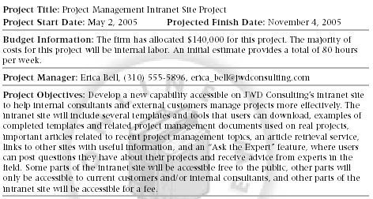
Project Charters

Slide 6
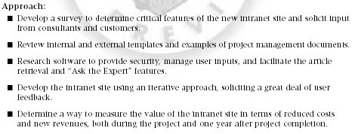
Project Charters

Slide 7
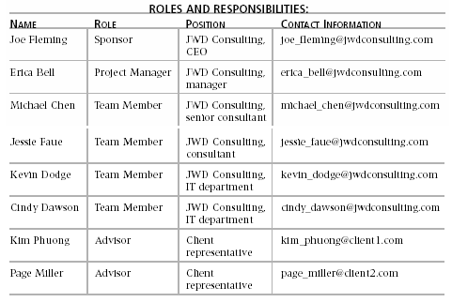
Project Charters

Slide 8
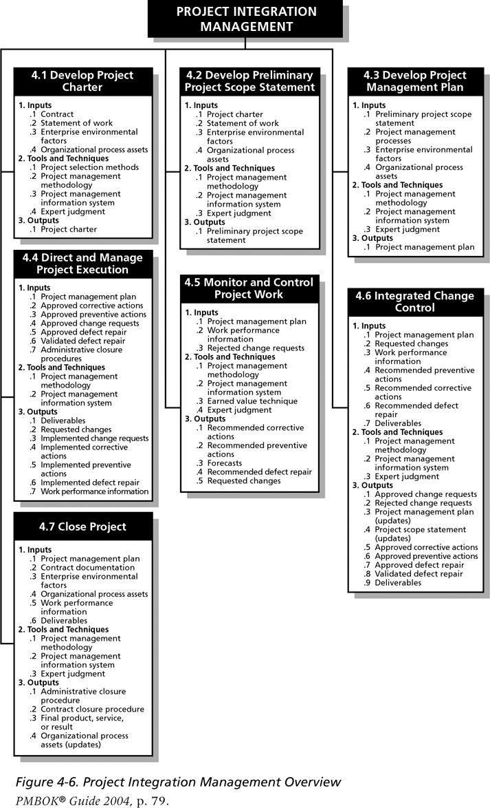
Figure 4-6. Project Integration Management Overview

Slide 9
Preliminary Scope Statements
A scope statement is a document used to develop and confirm a common understanding of the project scope.
It is an important tool for preventing scope creep:
The tendency for project scope to keep getting bigger.
A good practice is to develop a preliminary or initial scope statement during project initiation and a more detailed scope statement as the project progresses.

Slide 10
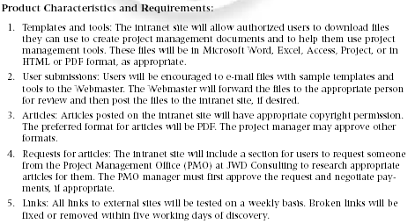
Scope Statement (Draft Version)

Slide 11
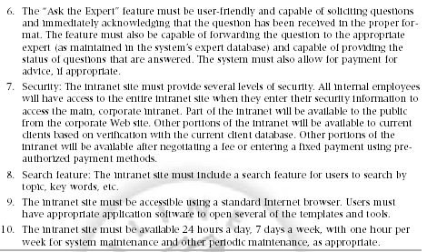
Scope Statement (Draft Version) (continued)

Slide 12
Project Management Plans
A project management plan is a document used to coordinate all project planning documents and help guide a project’s execution and control.
Plans created in the other knowledge areas are subsidiary parts of the overall project management plan.

Slide 13
Attributes of Project Plans
Just as projects are unique, so are project plans.
Plans should be:
Dynamic
Flexible
Updated as changes occur
Plans should first and foremost guide project execution by helping the project manager lead the project team and assess project status.

Slide 14
Common Elements of a Project Management Plan
Introduction or overview of the project.
Description of how the project is organized.
Management and technical processes used on the project.
Work to be done, schedule, and budget information.

Slide 15
Introduction of the Project
The project name
A brief description of the project and the need it addresses
The sponsor’s name
The names of the project manager and key team members
Deliverables of the project
A list of important reference materials
A list of definition and acronyms

Slide 16
Description of How the Project is Organized
Organizational charts
Project responsibilities
Other organizational or process-related information

Slide 17
Management and Technical Processes Used on the Project
Management objectives
Project controls
Risk management
Project staffing
Technical process

Slide 18
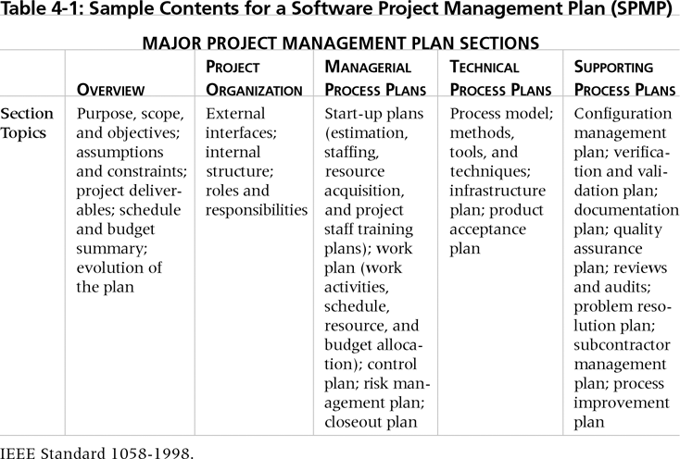
Table 4-1. Sample Contents for a Software Project Management Plan (SPMP)

Slide 19
What the Winners Do
“The winners clearly spell out what needs to be done in a project, by whom, when, and how. For this they use an integrated toolbox, including PM tools, methods, and techniques…If a scheduling template is developed and used over and over, it becomes a repeatable action that leads to higher productivity and lower uncertainty. Sure, using scheduling templates is neither a breakthrough nor a feat. But laggardS exhibited almost no use of the templates. Rather, in constructing schedules their project managers started with a clean sheet, a clear waste of time.”*
*Milosevic, Dragan and And Ozbay, “Delivering Projects: What the Winners Do,” Proceedings of the Project Management Institute Annual Seminars & Symposium (November 2001).

Slide 20
Stakeholder Analysis
A stakeholder analysis documents important (often sensitive) information about stakeholders such as:
Stakeholders’ names and organizations.
Their roles on the project.
Unique facts about each stakeholder.
Their level of influence on and interest in the project.
Suggestions for managing relationships with each stakeholder.

Slide 21
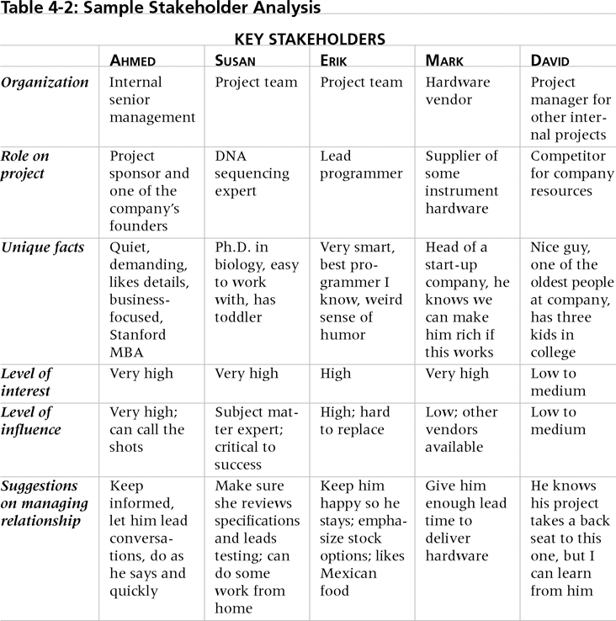
Table 4-2. Sample Stakeholder Analysis

Slide 22
Project Execution
Project execution involves managing and performing the work described in the project management plan.
The majority of time and money is usually spent on execution.
The application area of the project directly affects project execution because the products of the project are produced during project execution.

Slide 23
Project Execution
The project manager need to focus on leading the project team and managing stakeholder relationships to execute the project management plan successfully.
Project human resource management and project communications management are crucial.

Slide 24
Coordinating Planning and Execution
Project planning and execution are intertwined and inseparable activities.
Those who will do the work should help to plan the work.
Project managers must solicit input from the team to develop realistic plans.

Slide 25
Leadership and a Supportive Culture
Project managers must lead by example to demonstrate the importance of creating and then following good project plans.
Organizational culture can help project execution by:
Providing guidelines and templates.
Tracking performance based on plans.
Project managers may still need to break the rules to meet project goals, and senior managers must support those actions.

Slide 26
Important Skills for Project Execution
General management skills such as leadership, communication, and political skills.
Product, business, and application area skills and knowledge.
Use of specialized tools and techniques.

Slide 27
Monitoring and Controlling Project Work
Changes are inevitable on most projects, so it’s important to develop and follow a process to monitor and control changes.
Monitoring project work includes collecting, measuring, and disseminating performance information.
Two important outputs of monitoring and controlling project work include recommended corrective and preventive actions.

Slide 28
Integrated Change Control
Three main objectives are:
Influence the factors that create changes to ensure that changes are beneficial.
Determine that a change has occurred.
Manage actual changes as they occur.
A baseline is the approved project management plan plus approved changes.

Slide 29
Change Control System
A formal, documented process that describes when and how official project documents and work may be changed.
Describes who is authorized to make changes and how to make them.

Slide 30
Change Control Boards (CCBs)
A formal group of people responsible for approving or rejecting changes on a project.
CCBs provide guidelines for preparing change requests, evaluate change requests, and manage the implementation of approved changes.
CCBs include stakeholders from the entire organization.

Slide 31
Making Timely Changes
Some CCBs only meet occasionally, so it may take too long for changes to occur.
Some organizations have policies in place for time-sensitive changes.
A “48-hour policy” allows project team members to make a decision and have 48 hours to seek approval from top management. If the team decision cannot be implemented, management has 48 hours to reverse a decision; otherwise, the team’s decision is approved.
Another policy is to delegate changes to the lowest level possible, but keep everyone informed of changes.

Slide 32
Change Control
STOP

Slide 33
Closing Projects
To close a project, you must finalize all activities and transfer the completed or cancelled work to the appropriate people.
Main outputs include:
Administrative closure procedures.
Contract closure procedures.
Final products, services, or results.
Organizational process asset updates.

Slide 34
Using Software to Assist in Project Integration Management
Several types of software can be used to assist in project integration management:
Word processing software creates documents.
Presentation software creates presentations.
Spreadsheets or databases perform tracking.
Communication software such as e-mail and Web authoring tools facilitate communications.
Project management software can pull everything together and show detailed and summarized information.

Slide 35
Chapter Summary
Project integration management includes:
Developing a project charter.
Developing a preliminary project scope statement.
Developing a project management plan.
Directing and managing project execution.
Monitoring and controlling project work.
Performing integrated change control.
Closing the project.

